Slide 1

GreenLeaf Nursery
CAPSTONE PROJECT
PRESENTED BY
STUDENT NAME : SANDHYA THUKAKULA
COLLEGE NAME : KMM INSTITUTE OF PG STUDIES
DEPARTMENT : MCA

Slide 2
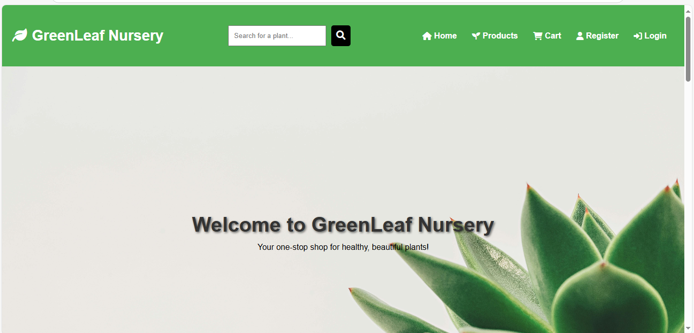
Project Overview
Purpose: Develop a lightweight, user-friendly online platform for small nurseries to showcase and sell plants.Target Audience: Small business owners and plant enthusiasts.Key Objective: Provide an attractive product gallery with browsing, cart, and user management features.

Slide 3
OUTLINE
Problem Statement (Should not include solution)
System Development Approach (Technology Used)
Algorithm & Deployment (Step by Step Procedure)
Result
Conclusion
Future Scope(Optional)
References

Slide 4
Problem Statement
Small nurseries and plant businesses lack an easy-to-use online platform to display their products.
Existing e-commerce solutions are often too complex and expensive for small-scale operations.
There is a need for a lightweight, visually appealing, and easy-to-manage plant gallery.
Must allow customers to browse, filter, and view details of plants interactively.

Slide 5
System Approach
Frontend Technologies:
HTML5 – Structure of the webpages (e.g., index.html, cart.html, login.html)
CSS3 – Styling and responsive layouts (e.g., styles1.css for grids and cards)
JavaScript – Dynamic interactivity (cart management, filtering, total calculation)
Backend Technologies:
PHP – User data handling and order management (e.g., fetch_user_data.php, booking.php)
Design Approach:
Clean and user-friendly interface with plant-themed visuals
Mobile-responsive design for accessibility on all devices
Modular separation of HTML, CSS, JS, and PHP files

Slide 6
Algorithm & Deployment
Product Catalog Creation
Define plant categories and details (image, price, description) in HTML/JS (e.g., 9 plants like Fiddle Leaf Fig, Succulent).
Frontend Design
Layout using HTML and CSS (grid & cards for product display in index.html).
Interactive Features
Add-to-Cart, Remove-from-Cart functions in JavaScript.
Real-time total price calculation.
Product filtering by category.
Modal views for plant details.

Slide 7
Algorithm & Deployment
Backend Integration
User registration/login via PHP (e.g., delivery_user_data.php).
Order booking and tracking (booking.php, orders.html).
Testing
Cross-browser compatibility (Chrome, Firefox, Edge)
Mobile responsiveness (using media queries)
Deployment
Host frontend on GitHub Pages / Netlify for free access.
Backend on server-supporting platform (e.g., Heroku or local XAMPP).

Slide 8
Result

Slide 9
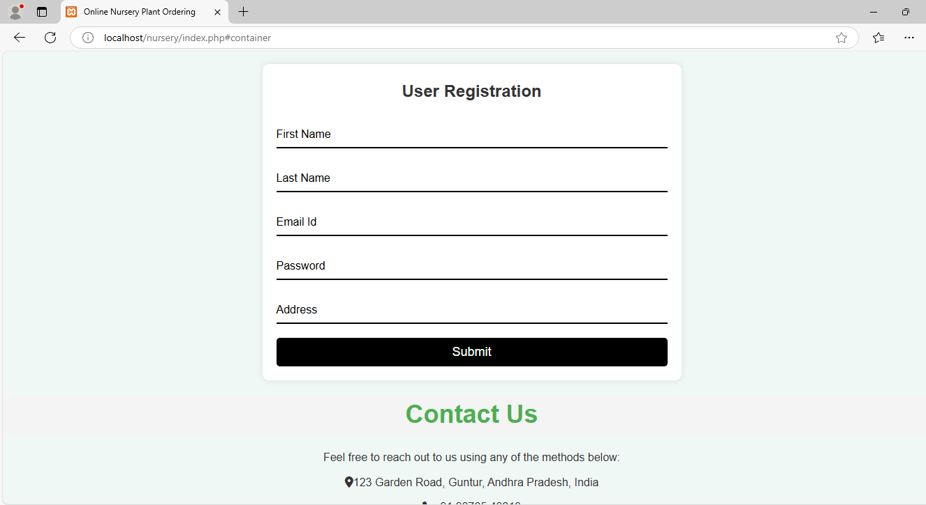

Slide 10
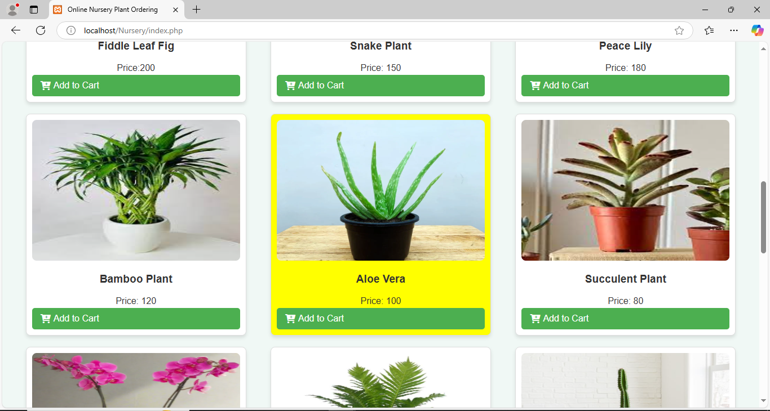

Slide 11
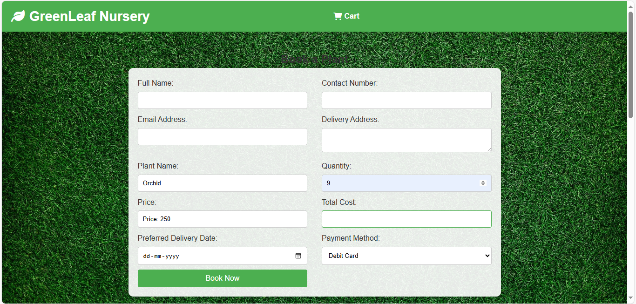

Slide 12
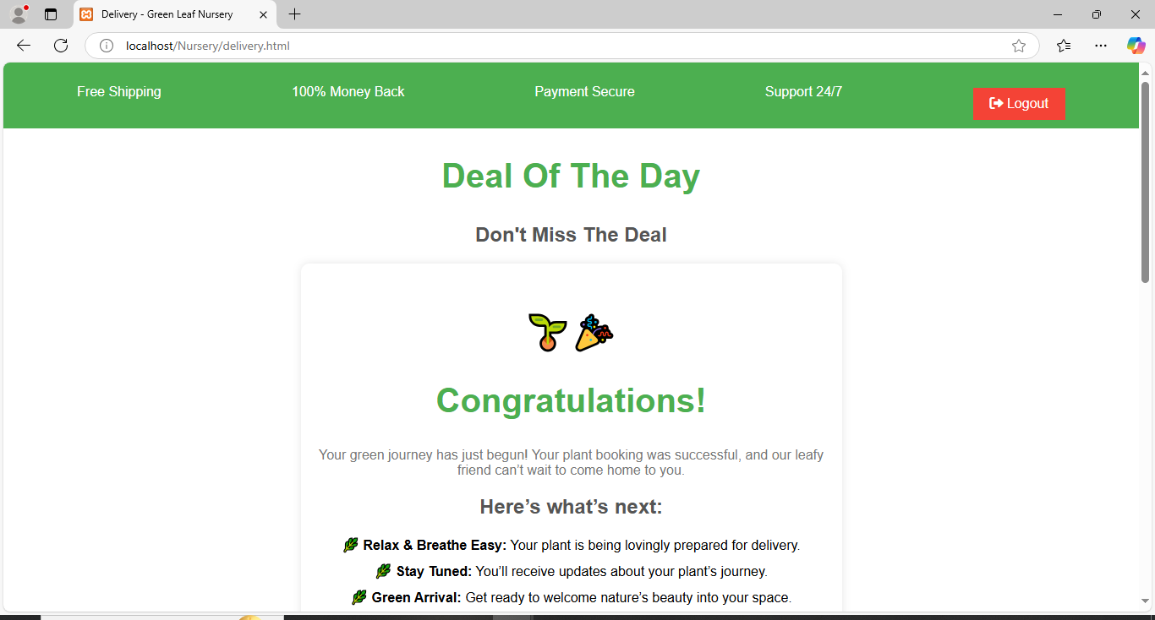

Slide 13
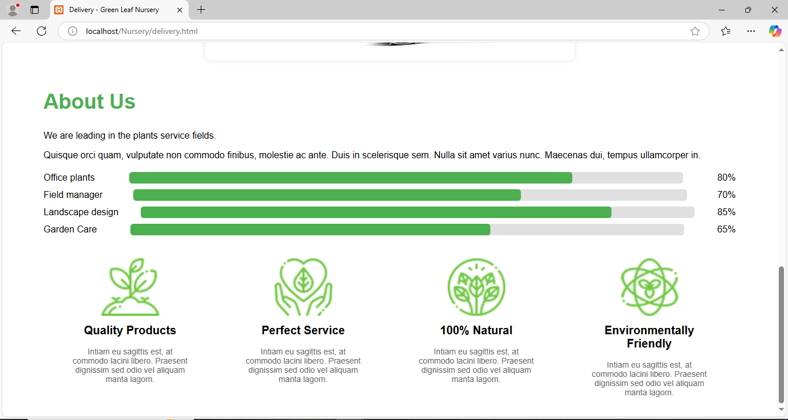

Slide 14
GITHUB AND DEPLOYMNET LINK
Attach your Github Link :
https://github.com/sandhya-shining-star/nursery-main.git

Slide 15
Conclusion
Provides a cost-effective online presence for small nurseries.
Eliminates dependency on complex e-commerce platforms.
Offers an engaging and interactive customer experience with backend support for orders.

Slide 16
Future scope(Optional)
Enhance backend with Node.js for advanced order management.
Secure payment gateway integration (e.g., Stripe or Razorpay).
Admin dashboard for inventory updates.
AI-based plant recommendations.

Slide 17
References
List and cite relevant sources, research papers, and articles that were instrumental in developing the proposed solution. NanthiniMoha/TNSDC-FWD-DIGITAL_PORTFOLIO
Get started with Bootstrap · Bootstrap v5.3
PHP Documentation (php.net)
JavaScript Tutorials (MDN Web Docs)
E-Commerce Frontend Guides (freeCodeCamp)

Slide 18


THANK YOU

